Slide 1
Elements of Medical Cytogenetics

Slide 2
Chromosome: chroma (colored) soma (body)
1954 recognition of 46 chromosomes not 48
1959 Down, Klinefelter, and Turner basis recognized

Slide 3
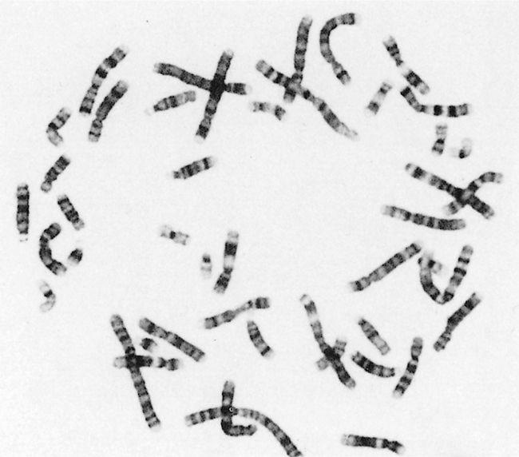
Banded chromosomes. Colored ones are also available!
FIGURE 1–1 The appearance of banded chromosomes, from a classical cytogenetic study.

Slide 4
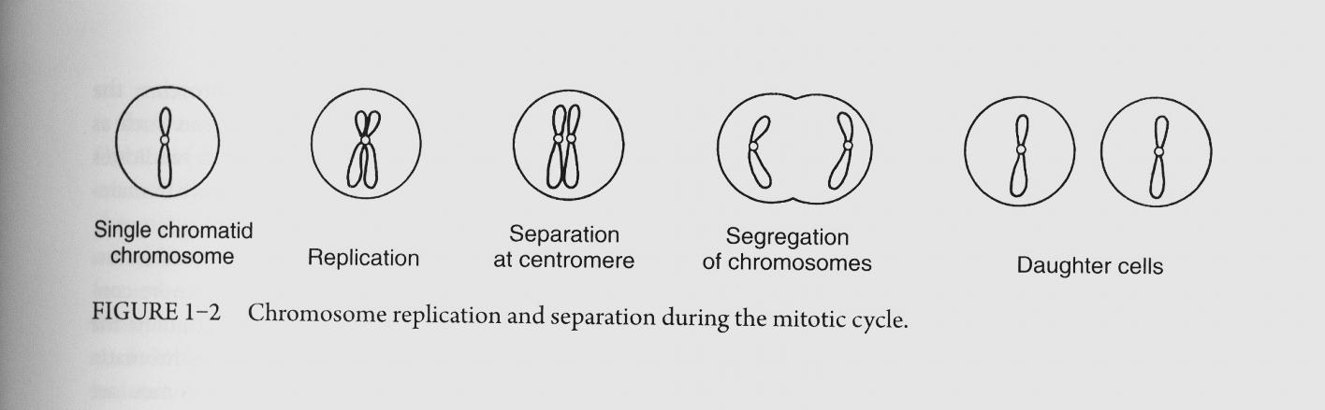
Chromosomal morphology
A chromosome contains two arms (p and q) and a centromere
After replication a chromosome is made of two sister chromatids
Routine classical cytogenetic analysis is done on mitotic representative blood lymphocytes

Slide 5
Genome
Homologous
Autosomes
Sex chromosomes (Gonosomes)
Haploid, gametocytes, ovum, sperm
Heterozygote, homozygote

Slide 6
Chromosomes are distinguishable on the basis of their:
Size
Centromere position
Banding pattern
Metacentric, submetacentric, acrocentric, telocentric
note from the lecture: there is 5 acrocentric chromosome in humans (chromosome 13, 14, 15, 21, and 22)

Slide 7
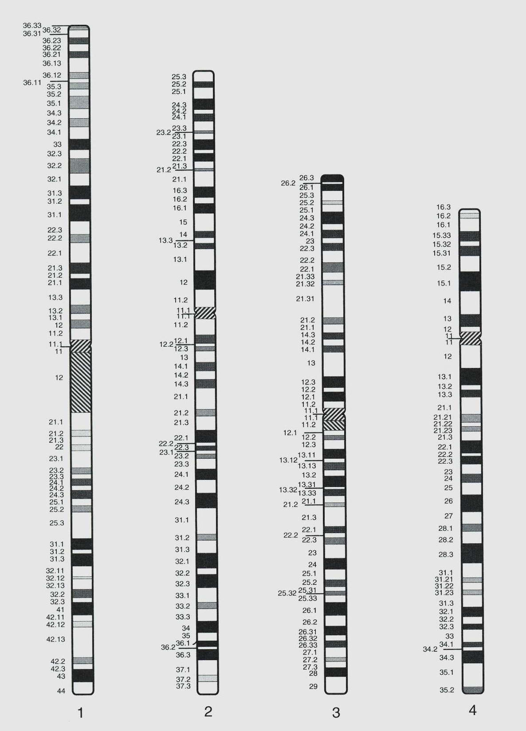
Ideogram: diagrammatic representation of the banding pattern

Slide 8
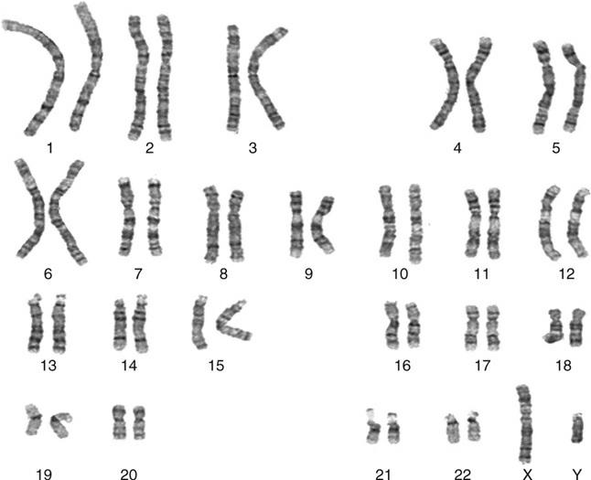
Karyotype
FIGURE 1–2 Chromosomes arranged as a formal karyotype, from a classical cytogenetic study.

Slide 9
Euchromatin: less condensed, contains coding DNA
Heterochromatin: more condensed, contains noncoding DNA
Telomeres: TTAGGG
Centromeres
Centromeric heterochromatin contains satellite DNA

Slide 10
Chromosome abnormality
Constitutional abnormality: a chromosome abnormality that is present from conception and involves the entire body
Constitutional mosaicism: if an additional cell line with a different chromosomal complement arises before the basis of the body structure is formed (i.e. in embryonic or pre-embryonic life) and becomes an integral part of the organism
Acquired chromosomal abnormality: happens later on, after body structure is formed.

Slide 11
An incorrect amount of genetic material carried out by the conceptus disturbs and distorts its normal growth pattern
Trisomy
Monosomy
Pathogenetic mechanisms that arise from chromosomal abnormalities:
A dosage effect with a lack (deletion) or excess (duplication) of chromosomal material
A direct damaging effect, with disruption of a gene at the breakpoint of a rearrangement
Genomic imprinting
A position effect, whereby a gene in a new chromosomal environment functions inappropriately

Slide 12
Full aneuploidy (i.e. Down, Klinefelter, Turner)
Partial aneuploidy
Loss of chromosomal material generally has a more devastating effect on growth of the conceptus than does an excess of material
Most full autosomal trisomies and virtually all full autosomal monosomies set development so awry that, sooner or later, abortion occurs – the embryo “self-destructs” and is expelled from the uterus
Brain is most complex; most vulnerable to less than optimal genetic constitution

Slide 13
Phenotype – first approach
To identify the chromosomal basis of many syndromes following analysis of groups of patients with similar phenotypes
Genotype – first approach
New syndromes are being identified based on their DNA aberration primarily due to use of microarray analysis

Slide 14
Sex chromosomal abnormality
Sex chromosomal imbalance has a much less deleterious effect on the phenotype than does autosomal aneuploidy
In both male and female, one, and only one, completely functioning X chromosome is needed
If an abnormal X chromosome is present, then, as a rule, cells containing this abnormal chromosome as the active X are selected against, perhaps due to preferential growth of those cells in which it is the normal X that is the active one

Slide 15
Frequency and impact of cytogenetic pathology
According to the window of observation, chromosomal disorders make a greater or lesser contribution to human mortality and morbidity
Overall, around 1 in 135 liveborn babies have a chromosomal abnormality, and about 40% of these are phenotypically abnormal
If we were to look at 5-day blastocysts, the fraction with abnormality might be close to a half
If we studied a population of 70-year-olds, we could expect to see very few individuals with unbalanced autosomal karyotype

